Slide 1




Heart Diseases

Slide 2

Motivation:
The motivation for the Heart Disease Prediction Project could be to help with early diagnosis and reduce the risk of death by identifying people at high risk of developing these diseases, enabling doctors to provide preventative care and guide patients toward lifestyle changes to improve their health.

Slide 3
Introduction to Heart Diseases:
Physiology
Anatomy
Risk Factors
Presented by :
Khaled Abd El-moniem
Faculty of Nursing
Mohammed Yasser Borham
Faculty of Medicine

Slide 4
Introduction:
Brief overview of heart diseases
Importance of understanding heart health

Slide 5
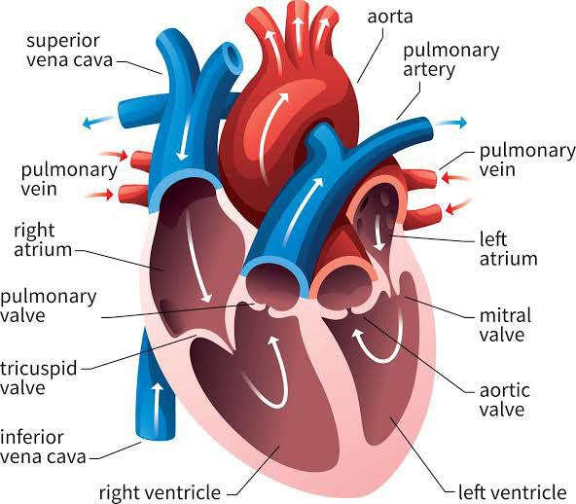
Anatomy of the Heart:
Structure of the heart:
- chambers (atria and ventricles)
- valves (tricuspid, pulmonary, mitral, aortic)
- major blood vessels (aorta, vena cava,
Pulmonaryarteries, and veins)
2. Diagram of the heart with labels

Slide 6
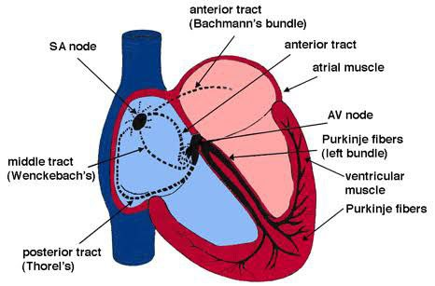
Heart Physiology
Function of the heart: pumping blood
through the body
Cardiac cycle: systole and diastole
Electrical conduction system: SA node, AV node (specialised muscle fibers), bundle of His, Purkinje fibers

Slide 7
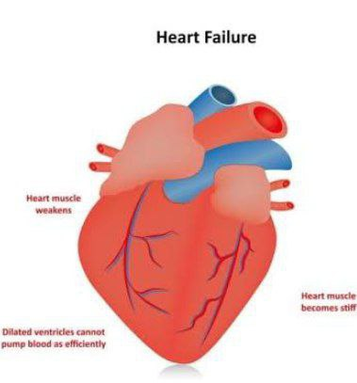
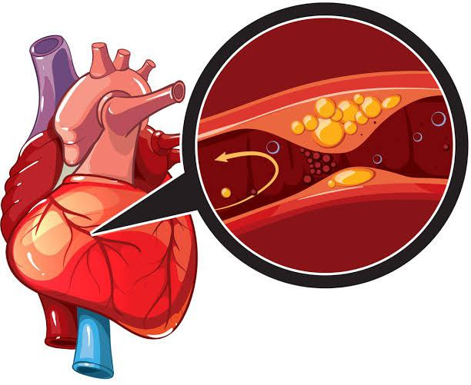
Types of Heart Diseases
Coronary artery disease (CAD)
Heart failure
Arrhythmias
Valvular heart disease
Congenital heart defects

Slide 8
Risk Factors for Heart Diseases
Modifiable: smoking, high blood pressure, high cholesterol, diabetes, obesity, physical inactivity, unhealthy diet
Non-modifiable: age, gender, family history, ethnicity

Slide 9
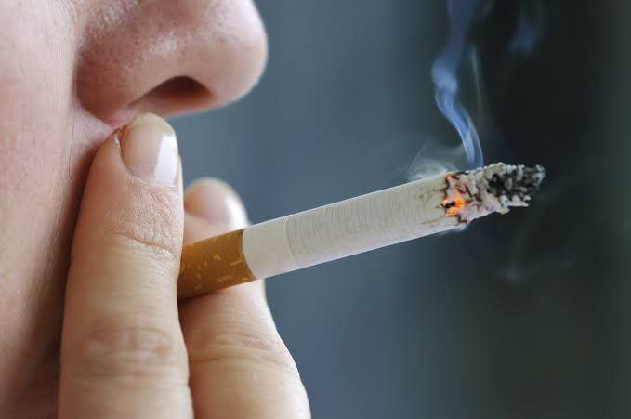
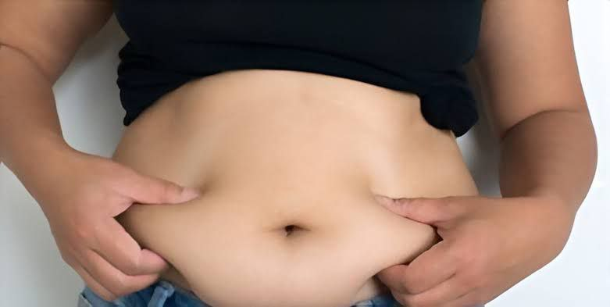
Modifiable Risk Factors in Detail
Smoking: impact on blood vessels, risk of atherosclerosis
High blood pressure: strain on heart, risk of CAD and stroke
High cholesterol: buildup of plaques in arteries

Slide 10

Non-modifiable Risk Factors in Detail
1. Age: increased risk with advancing age
2. Gender: differences in risk between men
and women
3. Family history: genetic predisposition
4. Ethnicity: higher risks in certain ethnic groups

Slide 11
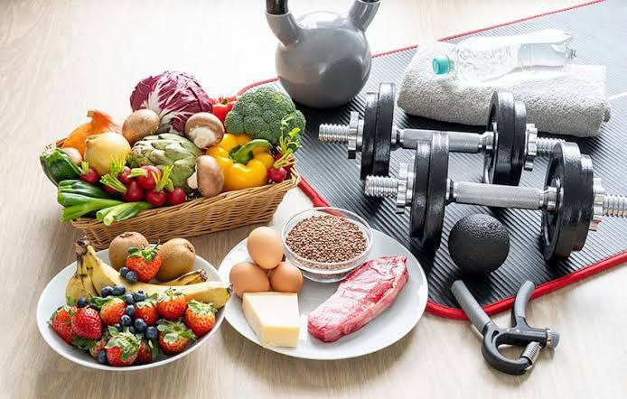
Prevention and Management
Healthy lifestyle: diet, exercise, no smoking
Regular check-ups: blood pressure, cholesterol levels
Medications: as prescribed by doctors
Awareness: recognizing symptoms and
seeking early intervention

Slide 12
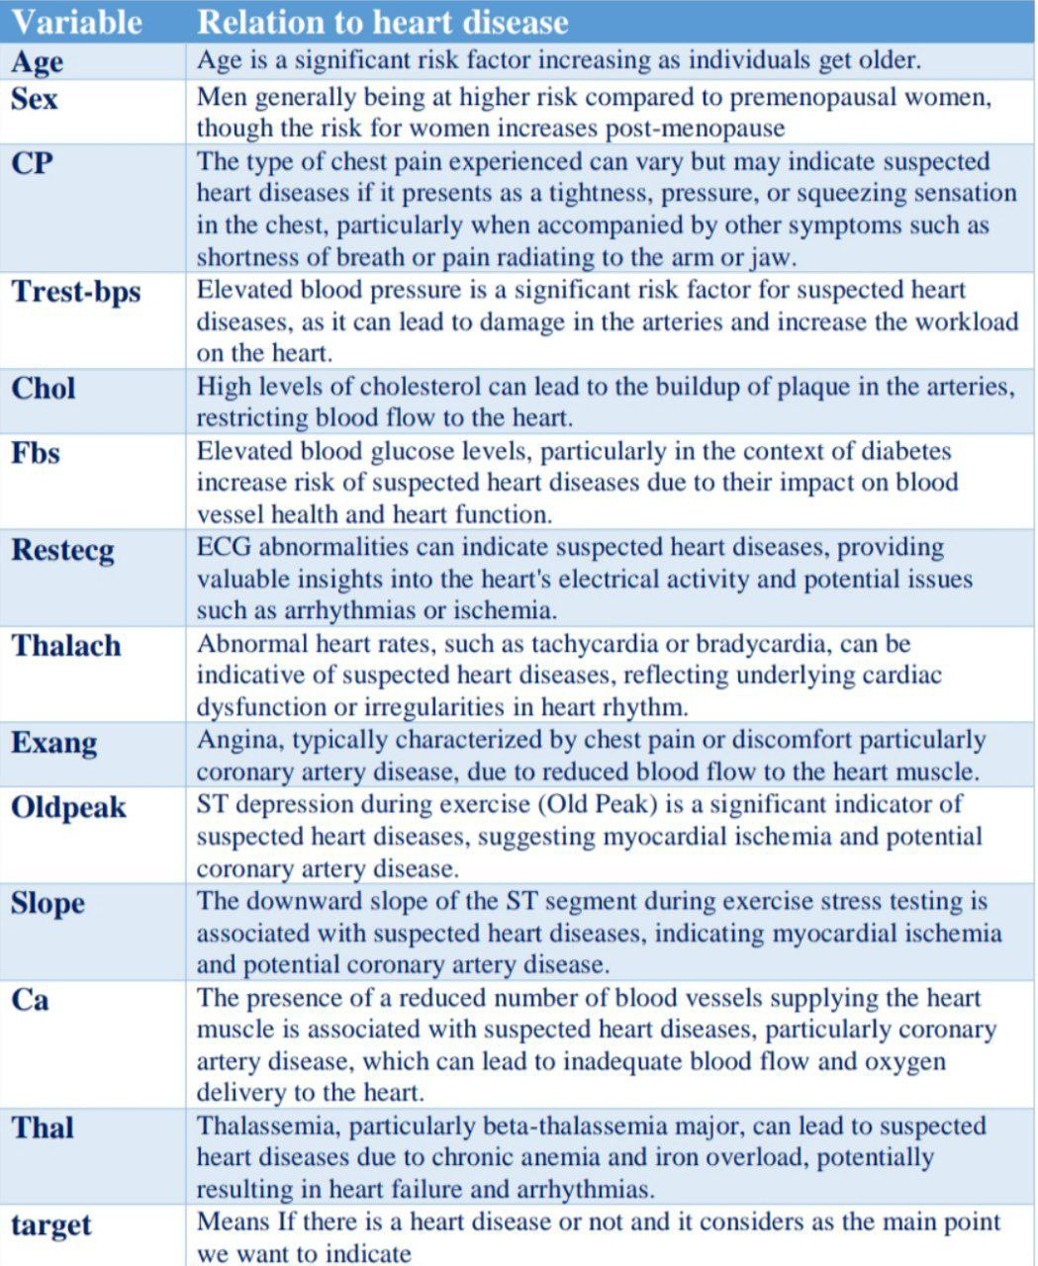

Slide 13
Heart Diseases Prediction
Using Machine Learning
Presented by :
Salma Mohamed Kishk
Dina Abdallah Shalaby

Slide 14
Outlines:
Data Collection
Data Analysis
Data Visualization
Data Modeling
Model Deployment

Slide 15
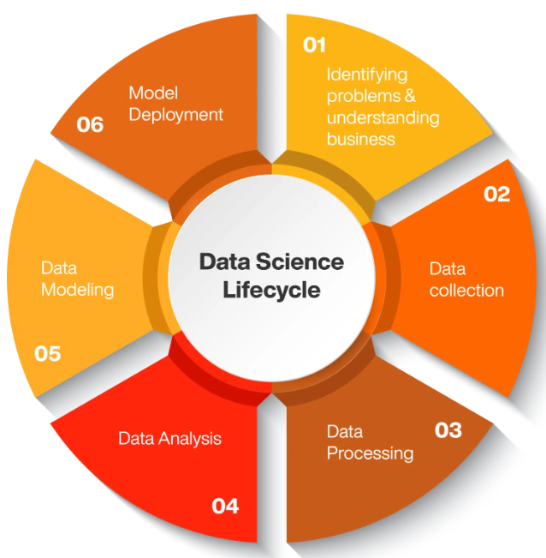
Identifying problems and understanding business
2. Data Collection
3. Data Processing
4. Data Analysis
5. Data Modeling
6. Model Deployment
Our goal is to develop a predictive model capable of accurately identifying individuals with heart disease

Slide 16


Define the problem

Slide 17

Data Collection
Kaggle:
https://www.kaggle.com/datasets/sid321axn/heart-statlog-cleveland-hungary-final
https://worldpopulationreview.com/country-rankings/heart-disease-rates-by-country
Kaggle is a data science platform and online community of data scientists and machine learning practitioners under Google. Kaggle enables users to find and publish datasets, explore and build models in a web-based data science environment, work with other data scientists and machine learning engineers.

Slide 18

Data Analysis
Is the process of cleaning ,transforming and modeling data to discover useful information for decision making
This is to extract useful information from data and taking the decision
This is where the statistical tools come in. we can use different methods to calculate things like averages, correlations, and probabilities. These calculations help identify patterns and trends in the data.

Slide 19




Slide 20
What is the best of python
Python is a high-level programming language
open source
easy to learn and has a simple syntax
Python is used for data analysis and data visualization
Python has a number of libraries that enable coders to write programs for data analysis and machine learning more quickly.

Slide 21

Pandas
Pandas is the most popular software library for data manipulation and data analysis for the python .
open-source software library built on top of Python specifically for data analysis
Pandas allows for importing and exporting tabular data in various formats, such as CSV
Pandas allows for various operations and for data cleaning features, including selecting a subset, creating derived columns, sorting, joining, filling, replacing, summary statistics, and plotting.
Easy handling of missing data

Slide 22

Data Preprocessing

Slide 23
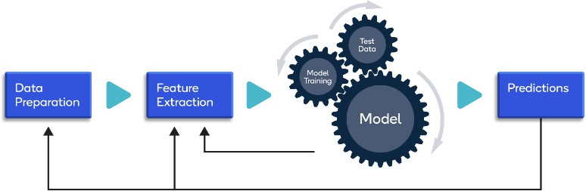
Preprocessing Data
Preprocessing Data
- process is converting categorical data into numerical data, as many machine learning algorithms require numerical input to perform calculations
- LabelEncoder

Slide 24
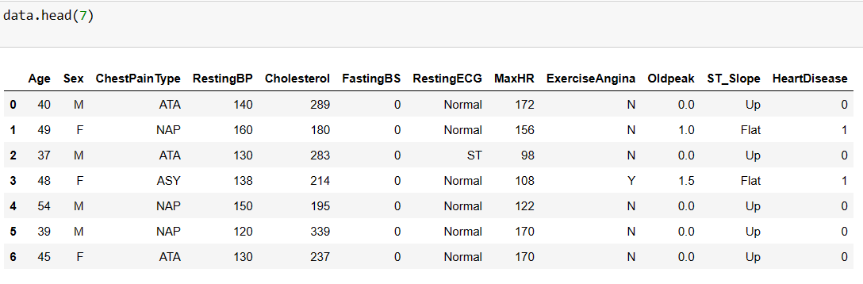
Dataset

Slide 25
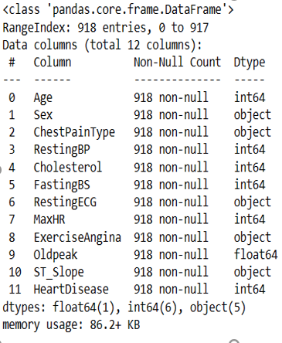
Data Information

Slide 26
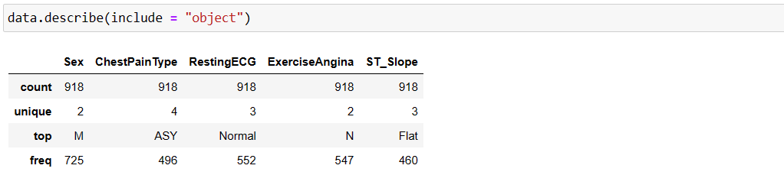
Statistical Overview on Categorical Data

Slide 27
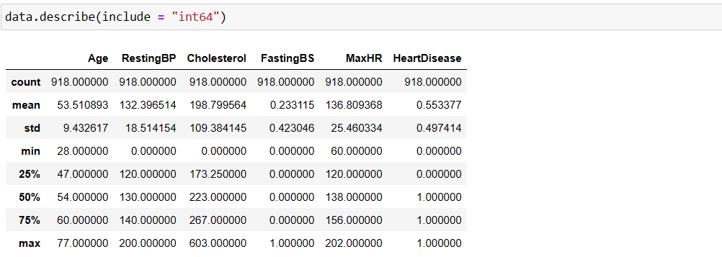
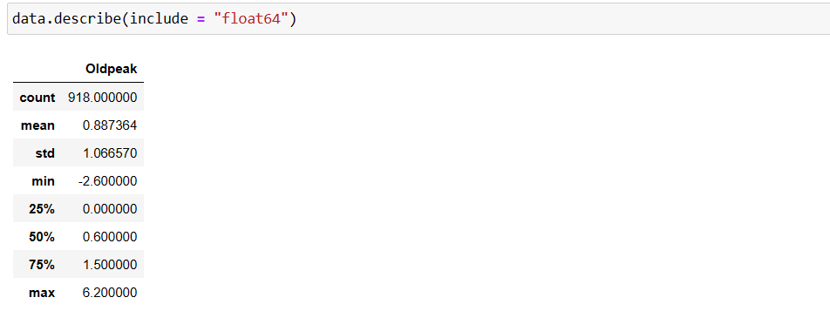
Statistical Overview on numerical Data

Slide 28
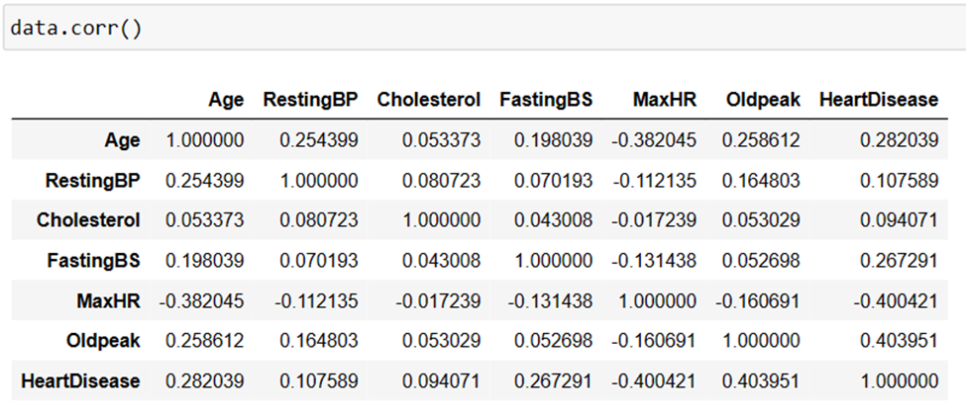
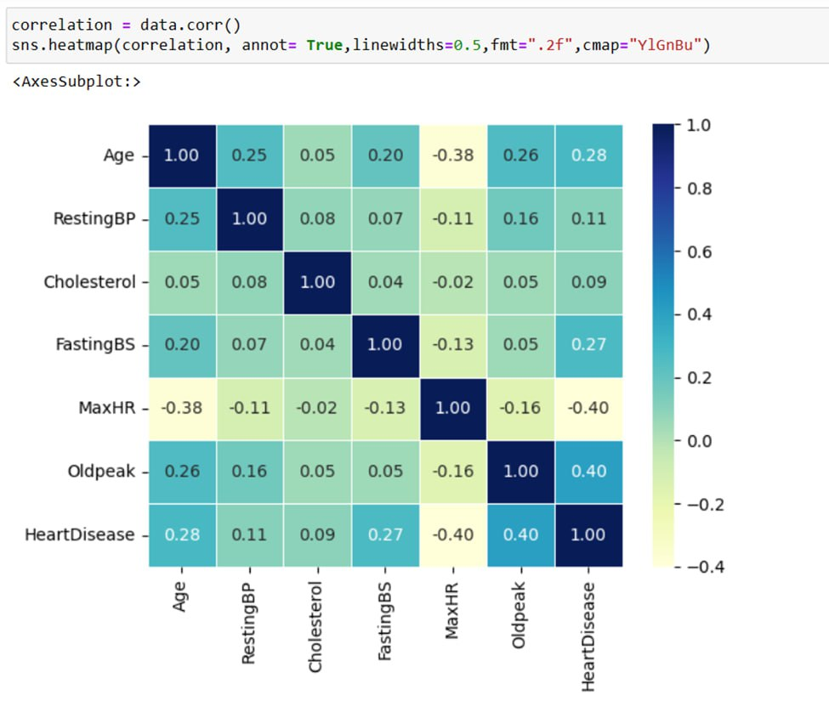

The Correlation

Slide 29

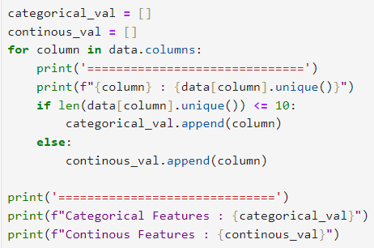
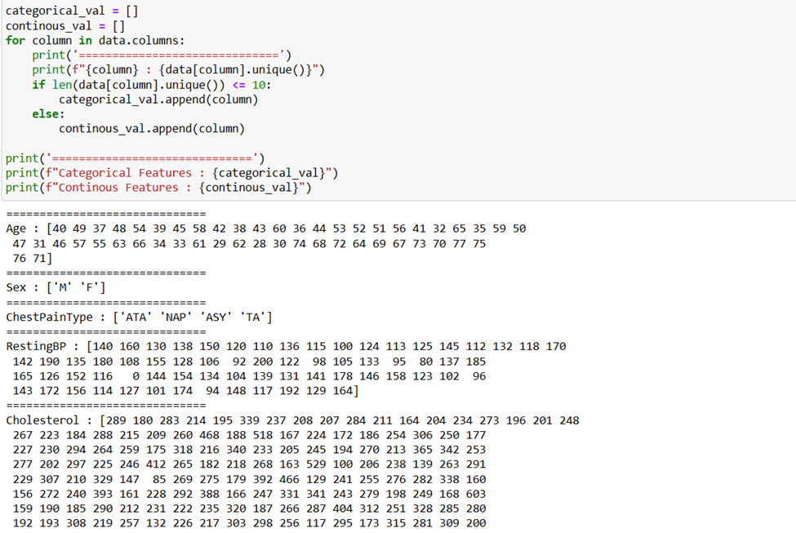
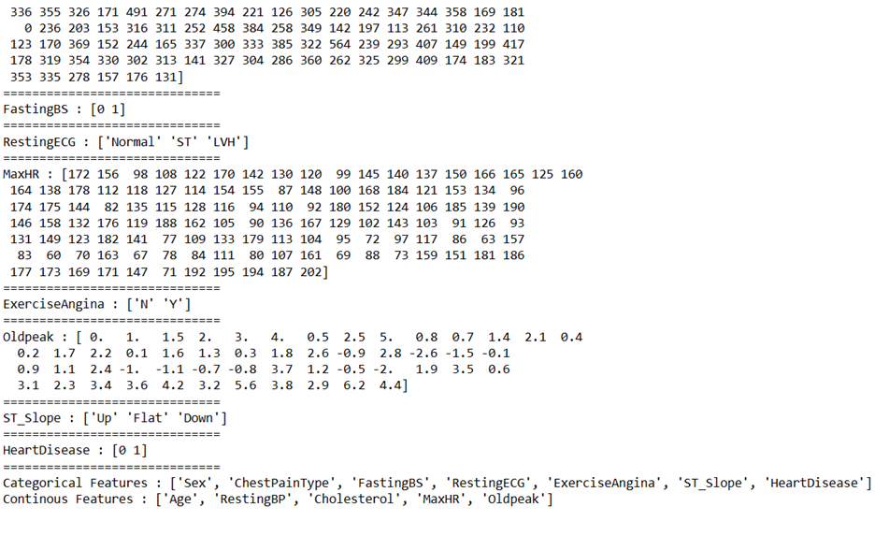
Unique Values

Slide 30
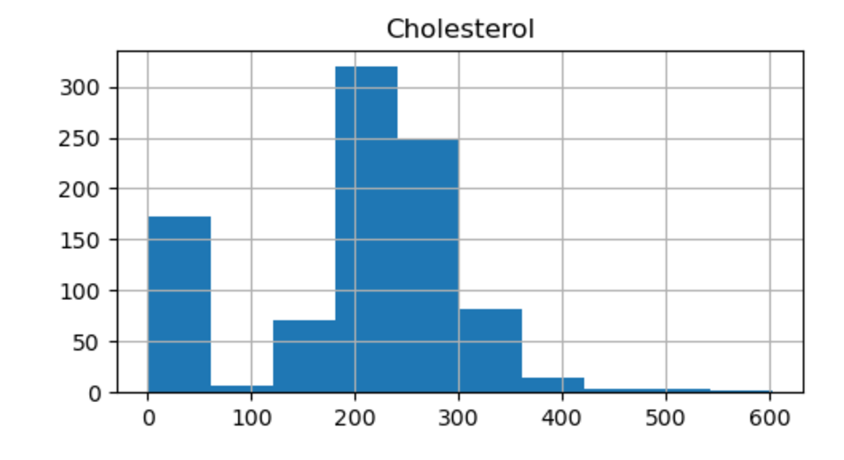
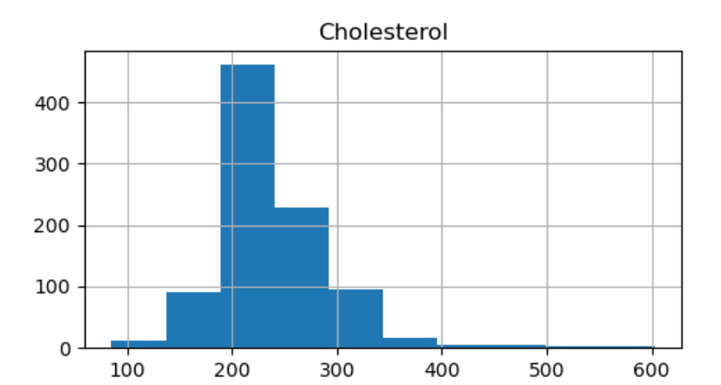
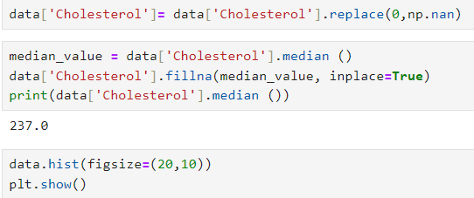
Cholesterol
We can show the difference between
this column before and after cleaning

Slide 31
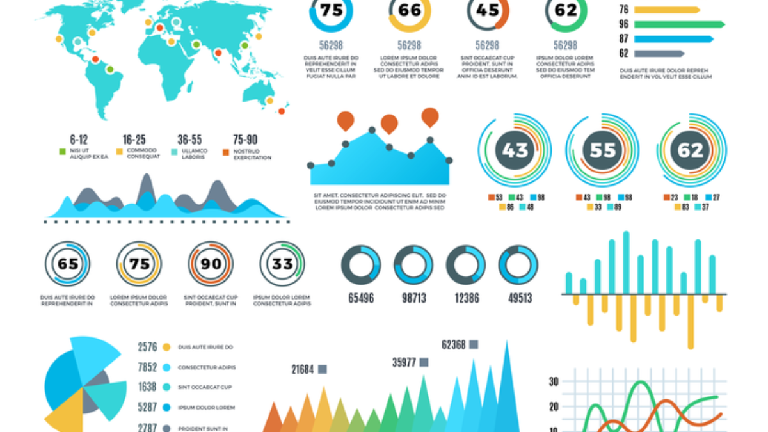

Data Visualization

Slide 32
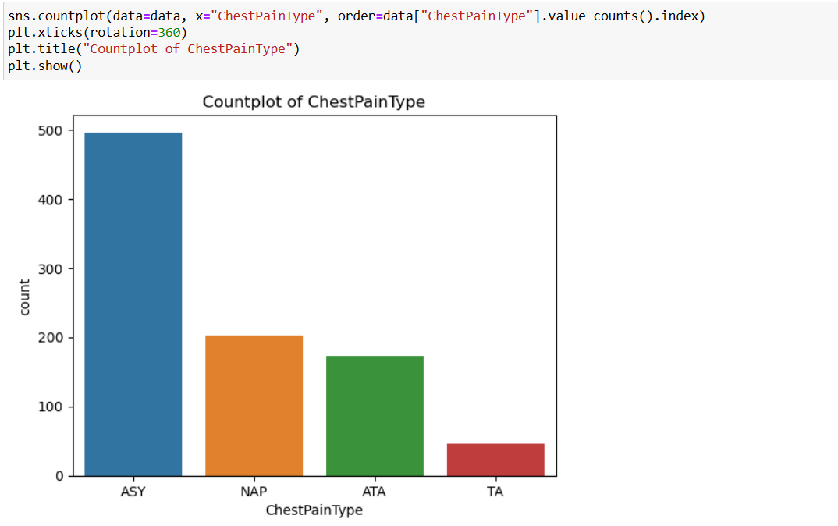
Data Visualization on Categorical Data

Slide 33
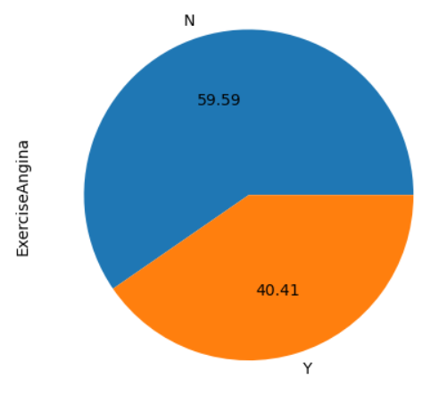
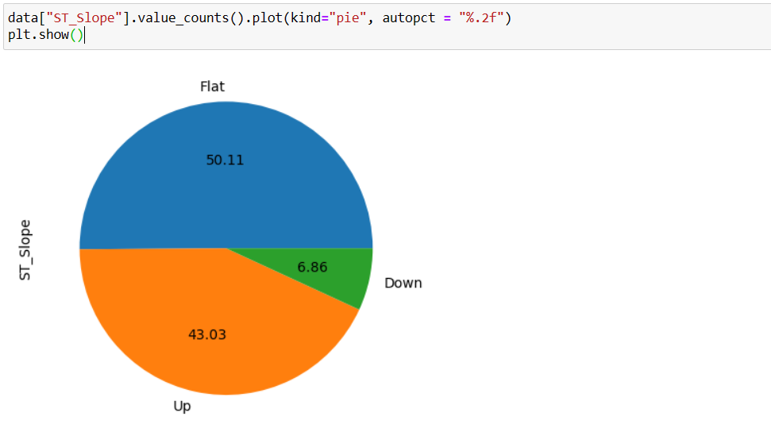
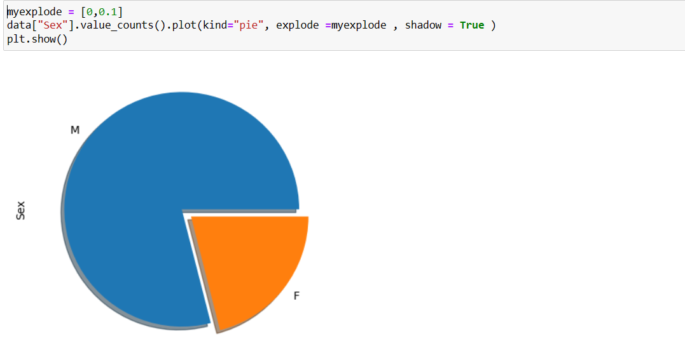
Data Visualization on Categorical Data

Slide 34
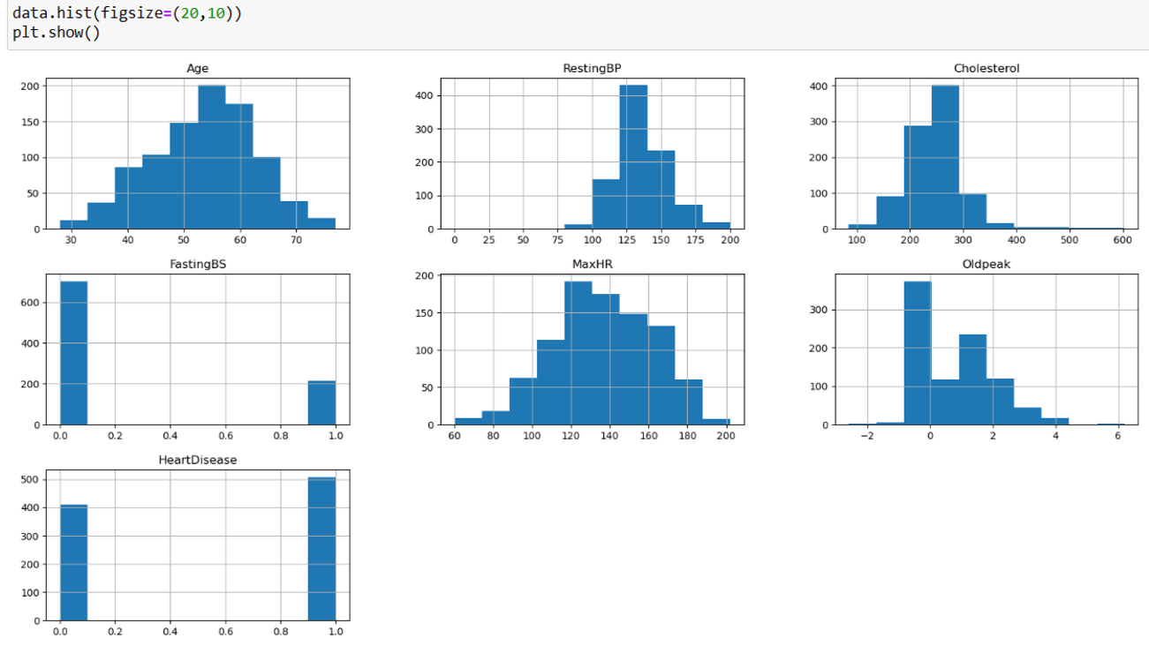
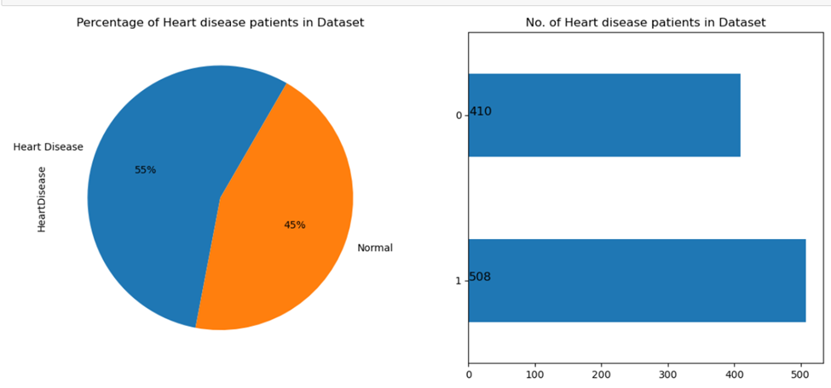
Data Visualization on Numerical Data

Slide 35
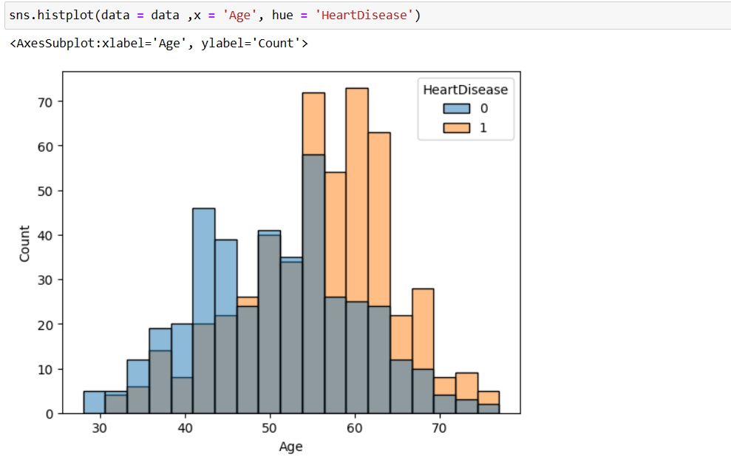
Heart Disease and Age Column

Slide 36
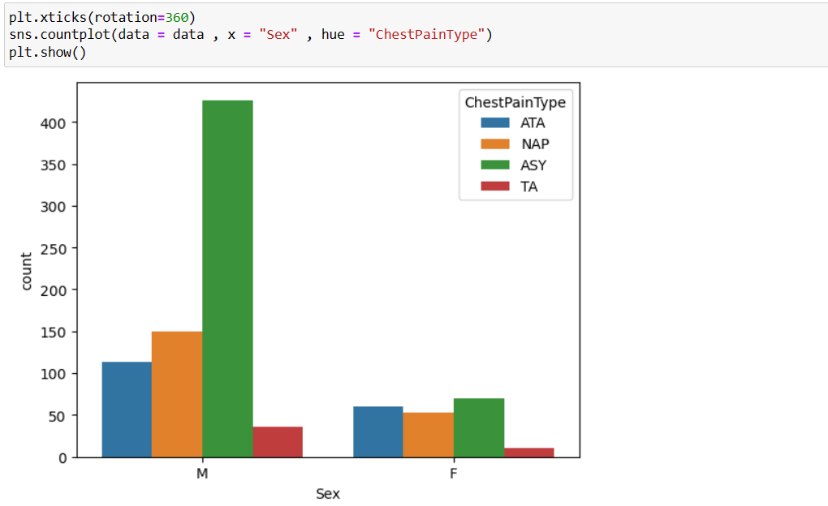
Purpose: Explore relationship between Sex v/s ChestPainType

Slide 37
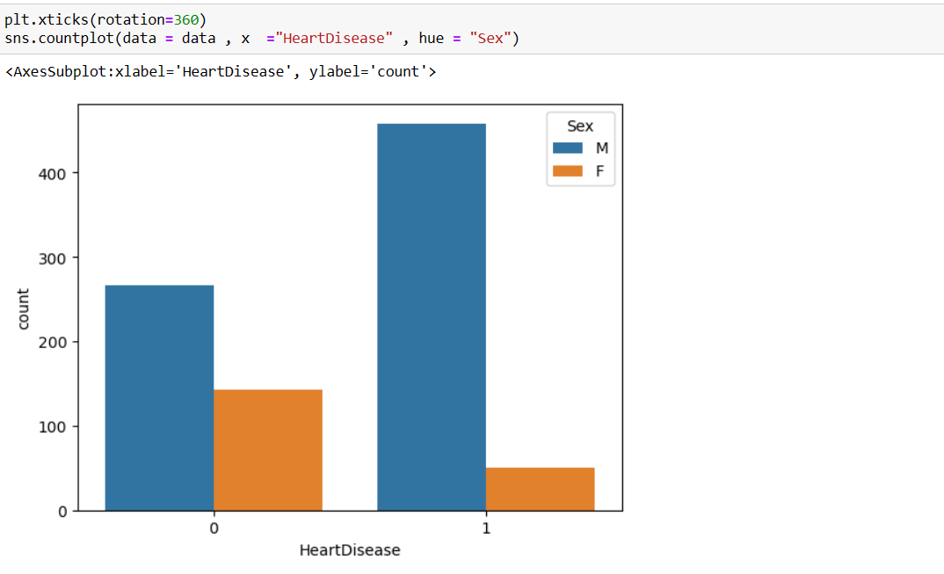
Heart Disease and Sex Columns

Slide 38
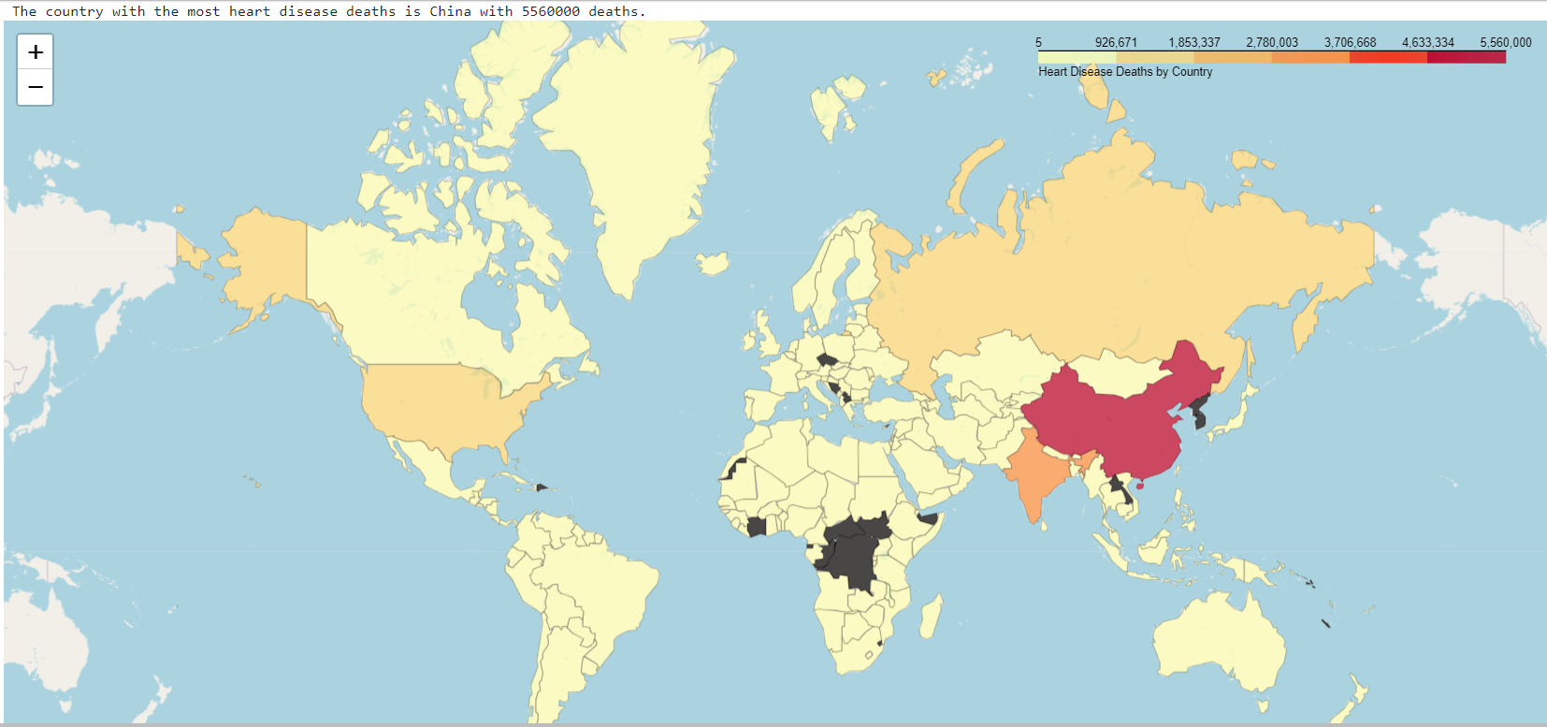
Heart Disease Deaths in 2021 by country

Slide 39

Data Modeling

Slide 40

Machine Learning

Slide 41
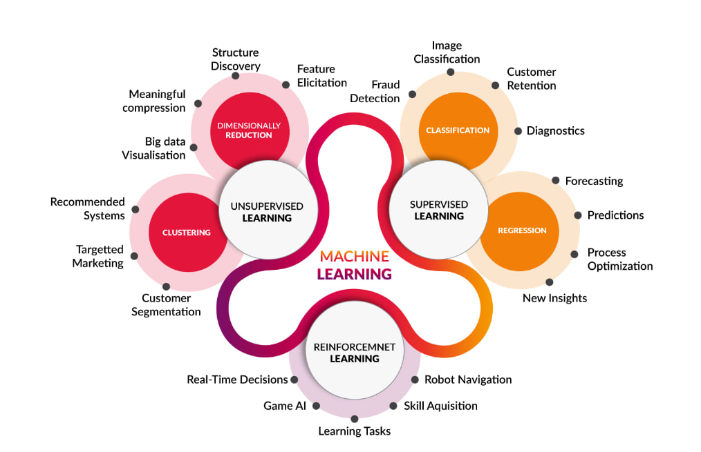
Types of Machine Learning

Slide 42
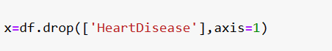
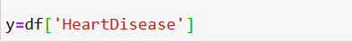
Separation of Features and Target
Separation of Features and Target: In supervised learning, it's crucial to separate the features (used for predictions) from the target variable (the outcome you are trying to predict). This setup is necessary because the machine learning algorithms need to learn from the features to make predictions about the target.

Slide 43
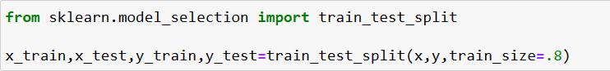
Preparing for Model Training
The train_test_split function is designed to split arrays or matrices into random train and test subsets. This ensures that both training and testing data reflect the overall distribution of the dataset, which is crucial for building models that generalize well to new, unseen data.We also used it in the project

Slide 44
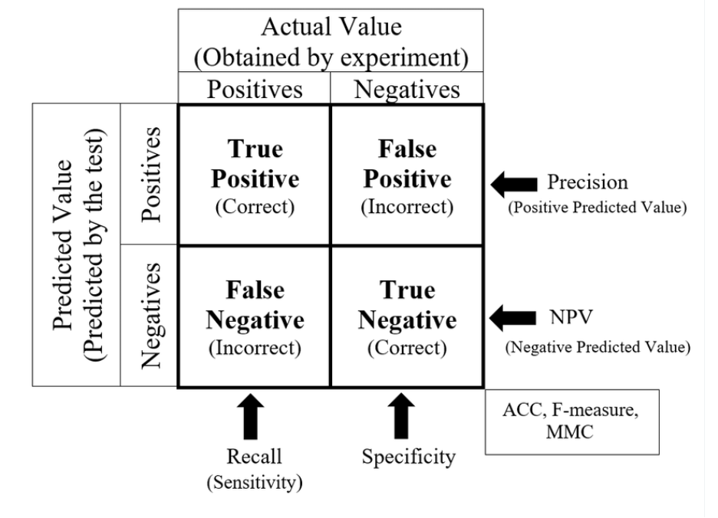
Confusion Matrix and Classification Report
Precision: This is the ratio of correctly predicted positive observations to the total predicted positives. It is a measure of a classifier's exactness. High precision relates to a low false positive rate.
Recall: This is the ratio of correctly predicted positive observations to all observations in the actual class. It is a measure of a classifier's completeness. A low recall indicates many false negatives.
F1-Score: The weighted average of Precision and Recall. This score takes both false positives and false negatives into account. It is particularly useful when the classes are imbalanced.
Support: The number of actual occurrences of the class in the specified dataset. This value can influence the weighted mean of the precision and recall for the report.

Slide 45
Algorithms :
K-Nearest Neighbors
Decision Tree Classifier
Gaussian Naive Bayes
Support Vector Machines
Random Forest Classifier
Gradient Boosting Classifier

Slide 46
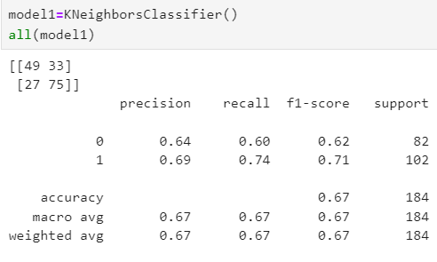
K-Nearest Neighbors

Slide 47
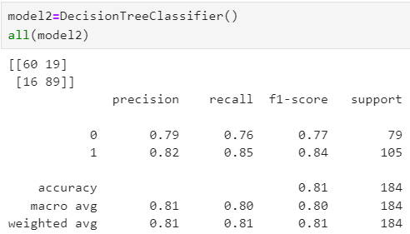
Decision Tree
Classifier

Slide 48
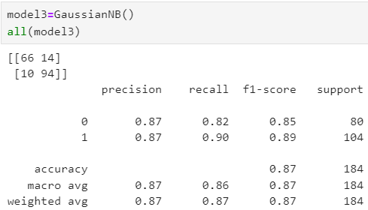
Gaussian Naive Bayes

Slide 49
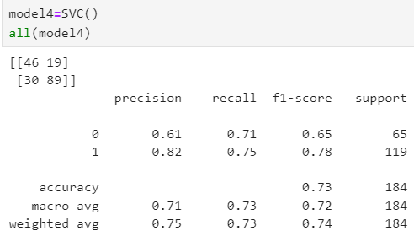
Support Vector
Machines

Slide 50
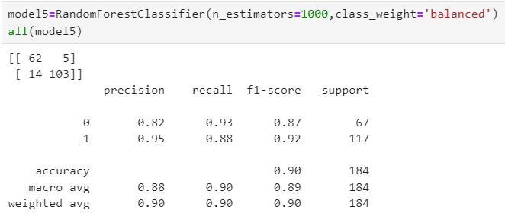
Random Forest
Classifier

Slide 51
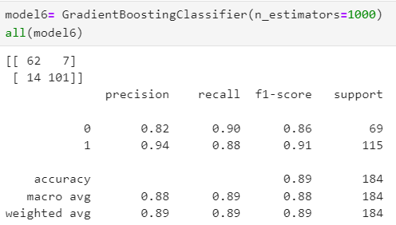
Gradient Boosting Classifier

Slide 52
Result of Algorithms after training
K-Nearest Neighbors (65%)
Decision Tree Classifier (80%)
Gaussian Naive Bayes (86%)
Support Vector Machines (74%)
Random Forest Classifier (83%)
Gradient Boosting Classifier (84%)

Slide 53
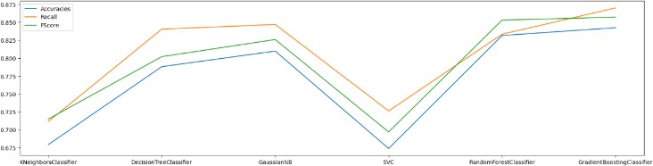
Diagram of Algorithms

Slide 54
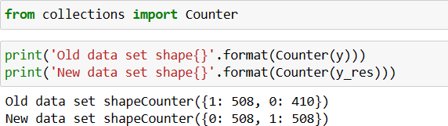
Installing imbalanced-learn
Improving model performance
imbalanced-learn

Slide 55
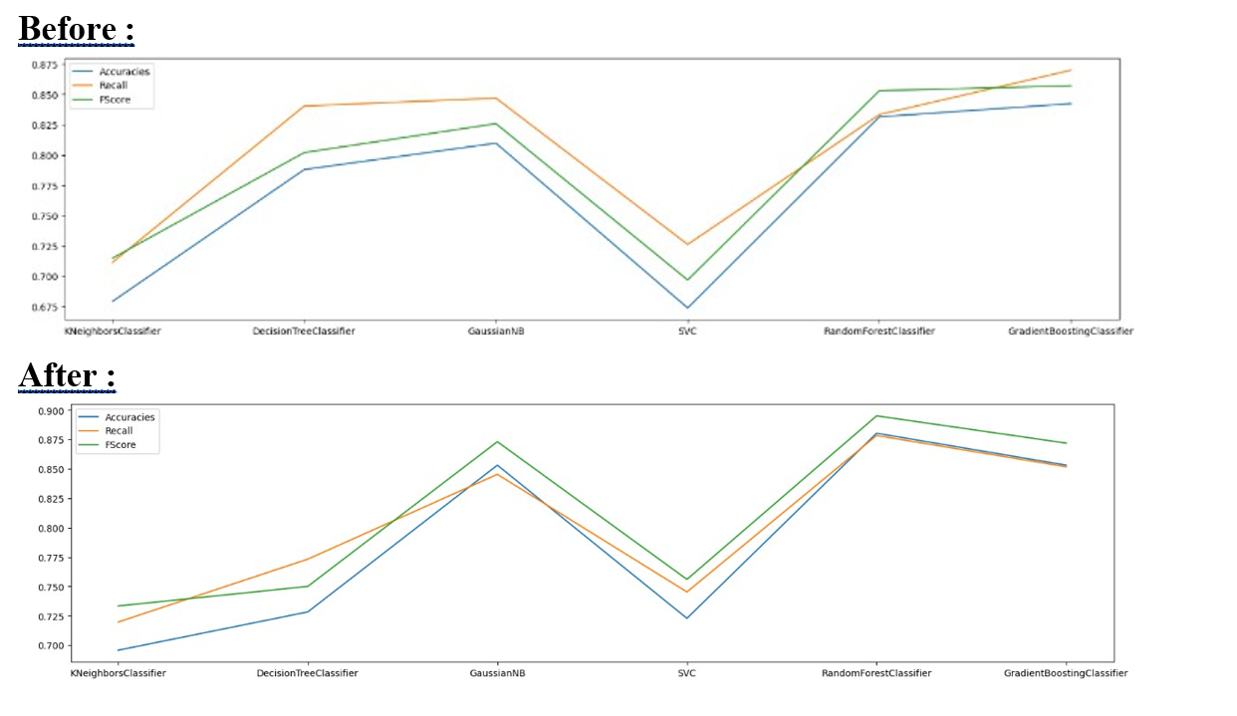
The result of the model’s performance after performing the improvement process
Accuracy rate 0.895 Approximately 90%
Features of Random Forest Classifier

Slide 56

Thank you!

